Slide 1
Nemak Group Meeting 2/3/2017

Slide 2
Topics
HPDC process
Research goals
Present work
Future work

Slide 3
Why study the HPDC process
Complicated process:
Rapid filling of mold
Moderately high pressure (80 Mpa)
Complicated geometry
Variable solidification conditions.
Risks:
Porosity
Shear banding
Unwanted microstructure = Coarse needle-like silicon and Fe-rich intermetallics

Slide 4
Research goals
Acquire data for A383 simulations
Predict macroscale solidification and filling conditions in casting.
Ansys Fluent
NovaCast NovaFlow&Solid
Interpolate cooling rates to finer microscale mesh
Microscale solidification structure simulation using cellular automata

Slide 5
Present work
Literature review
Novaflow&Solid simulations for solidification conditions
Fluent simulations for solidification conditions
Experimental results on size of eutectic and sludge-phase (Fe-rich intermetallic)

Slide 6
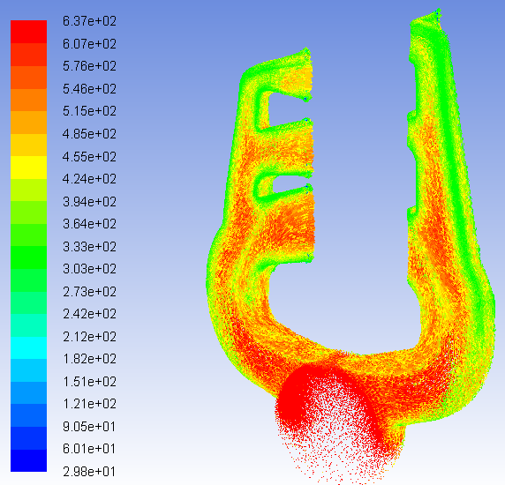
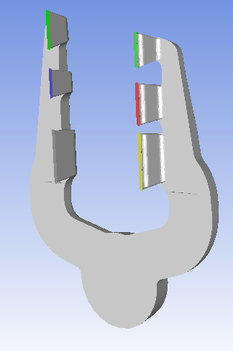
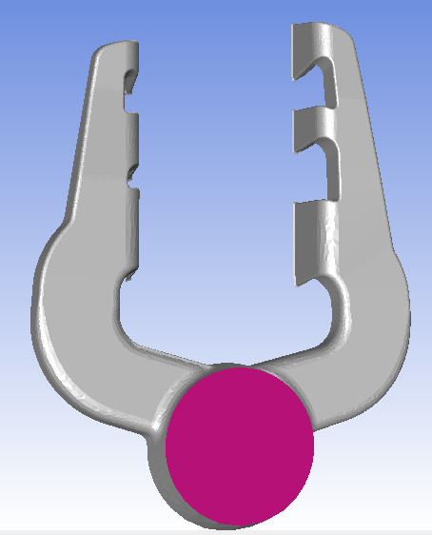
Fluent steady-state

Slide 7
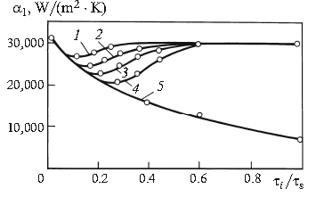
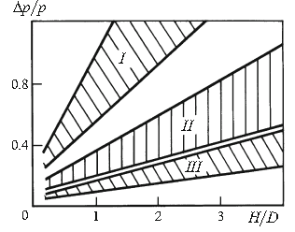
Pressure effect on cooling rate
Pressure drop for height/diameter in cylindrical casting
K.A. Batyshev. Casting of Aluminum Alloys with Pressure Crystallization. Part 1, Met Sci Heat Treat+ 53 (2012) 463-471.

Slide 8
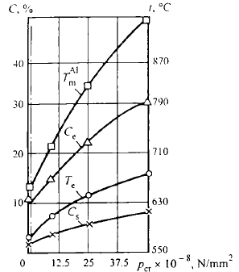
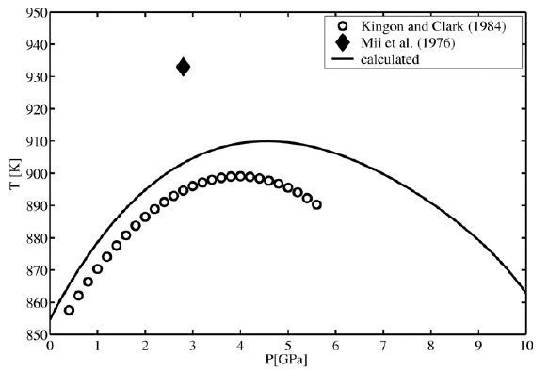
Pressure effect: eutectic temperature Eutectic temperature increases
L.V. Nikulin. Crystallization conditions and structure of Al-Si alloys in casting under pressure, Met Sci Heat Treat+ 39 (1997) 384-389.
E. Brosh, G. Makov, R.Z. Shneck. Application of CALPHAD to high pressures, Calphad 31 (2007) 173-185.
J.J. Sobczak, L. Drenchev, R. Asthana. Effect of pressure on solidification of metallic materials, Int J Cast Metal Res 25 (2012) 1-14.

Slide 9
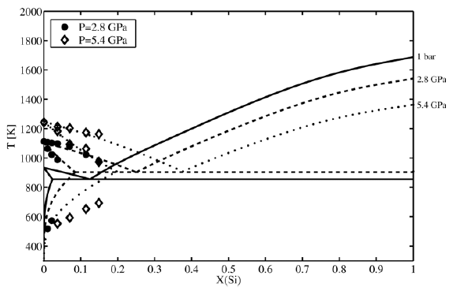
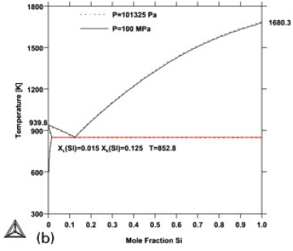
Pressure effect: phase diagram Diagram moves up and to the right!
J.J. Sobczak, L. Drenchev, R. Asthana. Effect of pressure on solidification of metallic materials, Int J Cast Metal Res 25 (2012) 1-14.
E. Brosh, G. Makov, R.Z. Shneck. Application of CALPHAD to high pressures, Calphad 31 (2007) 173-185.

Slide 10
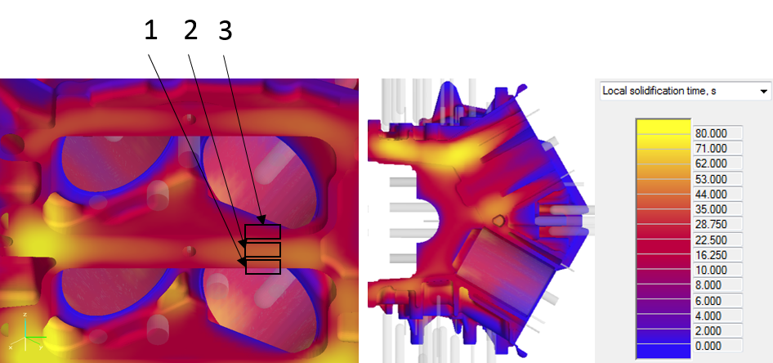
NovaCast NovaFlow&Solid

Slide 11
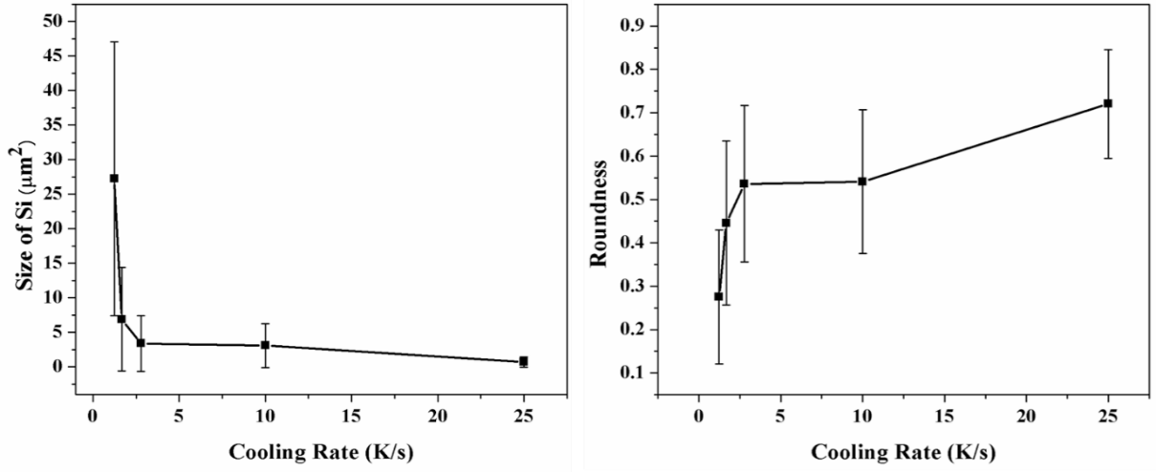
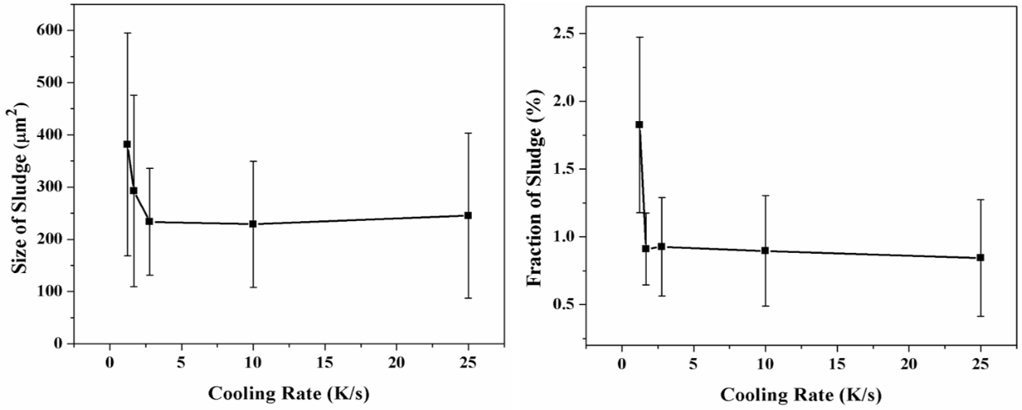
Results
Silicon
Sample | Cooling rate, K/s
1 | 1.7
2 | 1.2
3 | 2.8
4 | 10
5 | 25
Sludge

Slide 12
Conclusions
1. At cooling rate above 2.5 K/s, mean particle size for sludge and silicon dramatically increase
2. Particle size appears to have a logarithmic relationship with simulated solidification time
3. More experimental work is needed to determine the sludge formation mechanism.

Slide 13
Future work
Microscale simulations
Interpolate solidification conditions from fluent simulations to cellular automata mesh.
Predict microstructure

